Slide 1
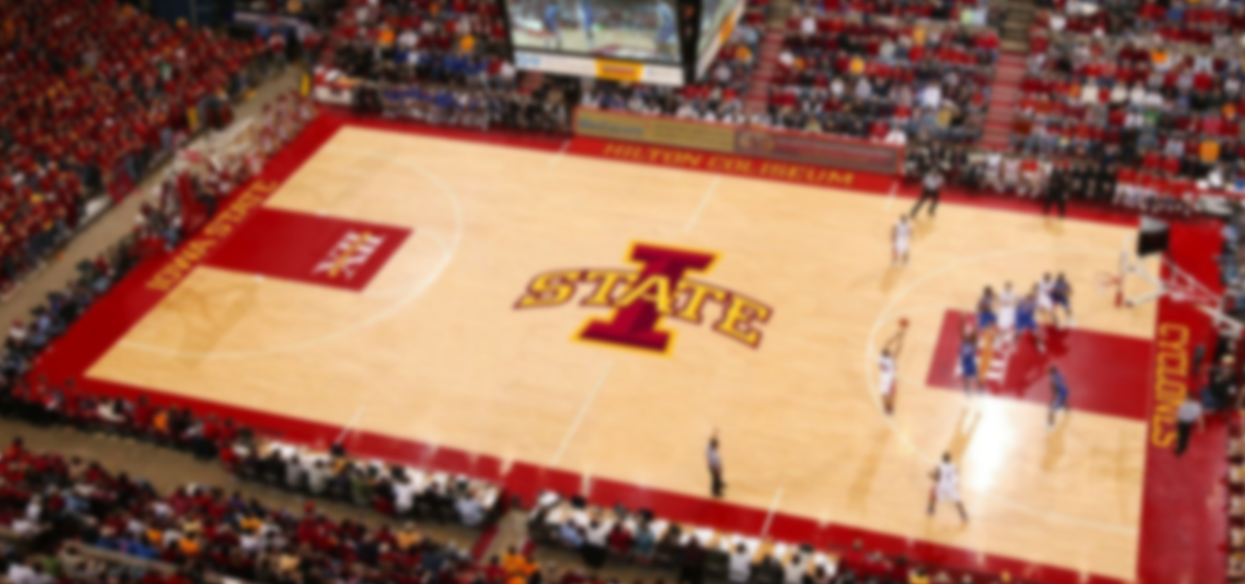
Web Tournaments
GROUP 7

Slide 2

The Team
Michael Davis
SE, WebFilings Intern
Max Peterson
SE, WebFilings Intern
Robert Sheehy
SE, WebFilings Intern
Mark Gollnick
CprE, WebFilings Intern
Taehyun Park
CprE, ITS Mobile App Developer
Notes:
Introduce team members. Each member introduce brifely themselves

Slide 3
Contents
1. Web Tournaments
2. Application Analysis
3. Development Process
4. Application Demonstration
`
Notes:
We’ve got four things that we’d like to talk about in this presentation, web tournaments. 1. Web Tournaments, 2. Application Analysis we are going to check more of
3. Development Process (changes that we had to made and what we implemented) Lastly, 5 minutes demo

Slide 4

WEB TOURNAMENTS
Notes:
Move to the next slide after 3 seconds

Slide 5
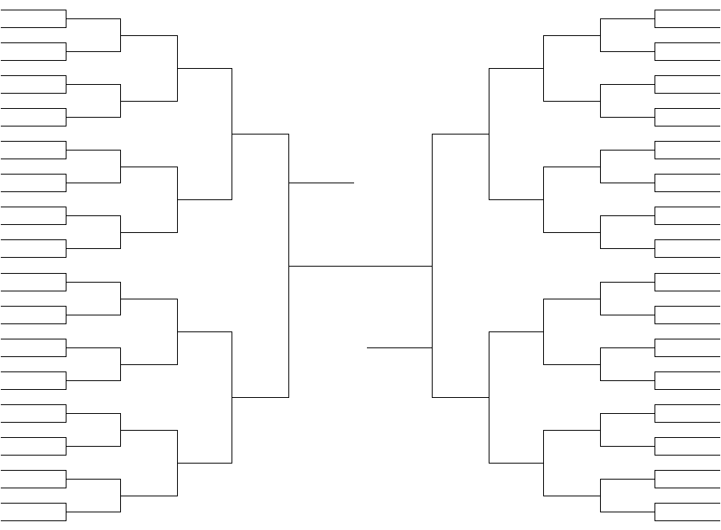
Problem Statement
Notes:
Quickly drawing brackets and determining seeds by hand is tedious and time consuming. There are currently no applications that will allow a user to quickly and easily set up a bracket without having to deal with some aspect of setup manually. Our application does this job.

Slide 6



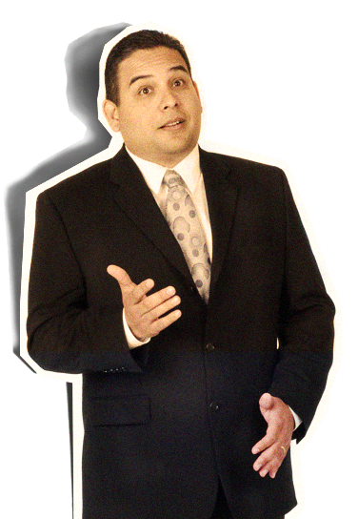
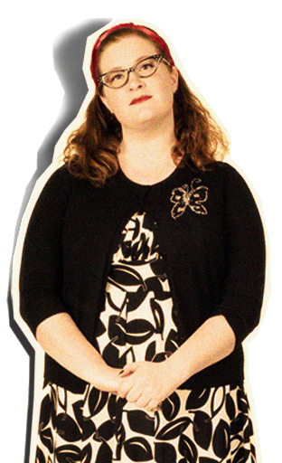
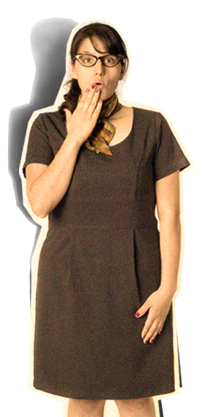
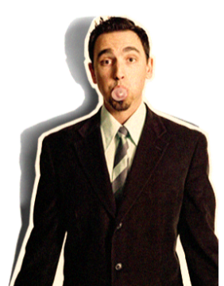
Target Audience
Easy to use
COOL
So
Notes:
The target audience for our app is everyone who wants to set up their own tournament can be users. Here everyone, including non tech people

Slide 7
Usability Features
Tournaments
Create, edit, delete tournaments
Decide tournament rules
Determine match winner
Administer tournament permissions
View tournaments in progress

Slide 8
Usability Features
Users
Account creation
Account login
Account edit
Create groups for easy tournament creation

Slide 9



2
APPLICATION
ANALYSIS
Notes:
Move to the next slide after 2 seconds

Slide 10

Platform
Google AppEngine
Easy
Affordable
Scaleable
Notes:
Cloud environment for running Python, Java, and Go based web applications

Slide 11





Languages / Frameworks
Python
Flask
A lightweight Python web framework
AppEngine Datastore
Delicious NoSQL database
jQuery
Making JavaScript not horrible since 2006
SVG
Displaying tournament bracket

Slide 12
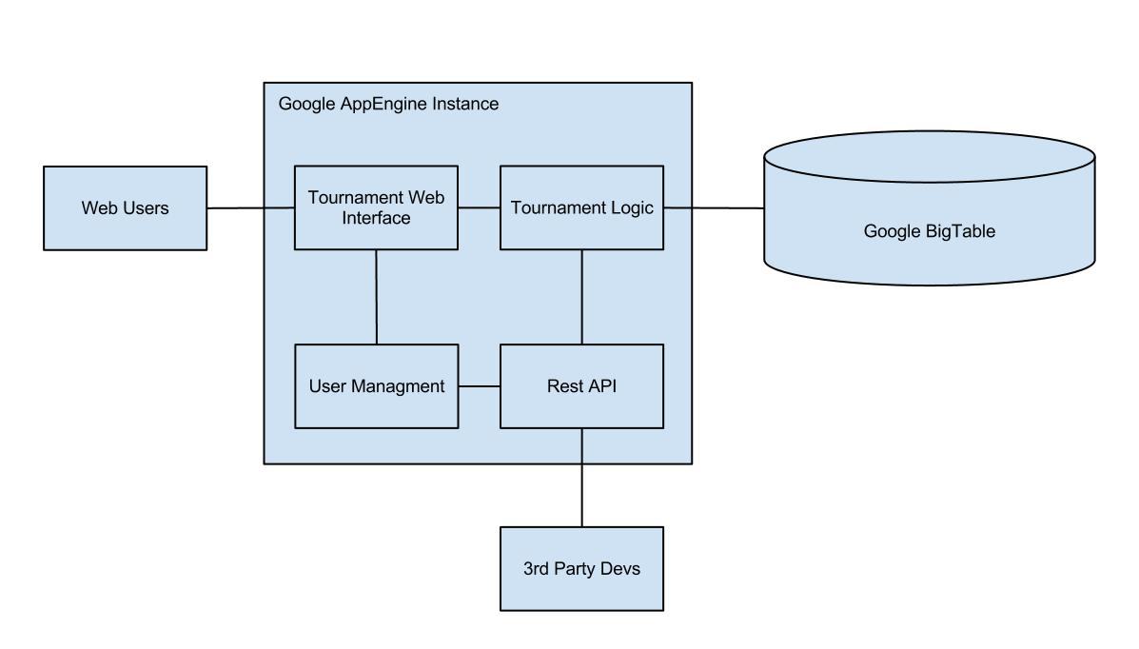

Architectural View

Slide 13


Collaboration
Github
Easy code reviews on pull requests
Easy branching for keeping code organized
Maintainable after semester ends
Stashing is invaluable when making quick changes
Trello
Collaboration tool that organizes your projects

Slide 14
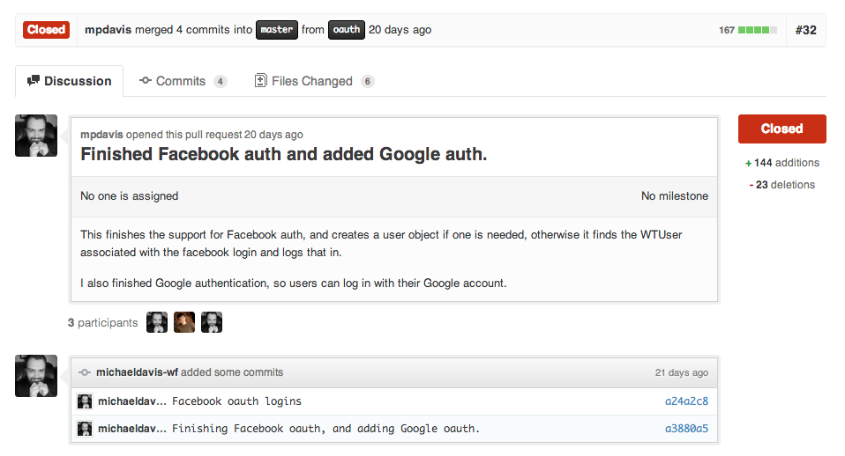
Github

Slide 15
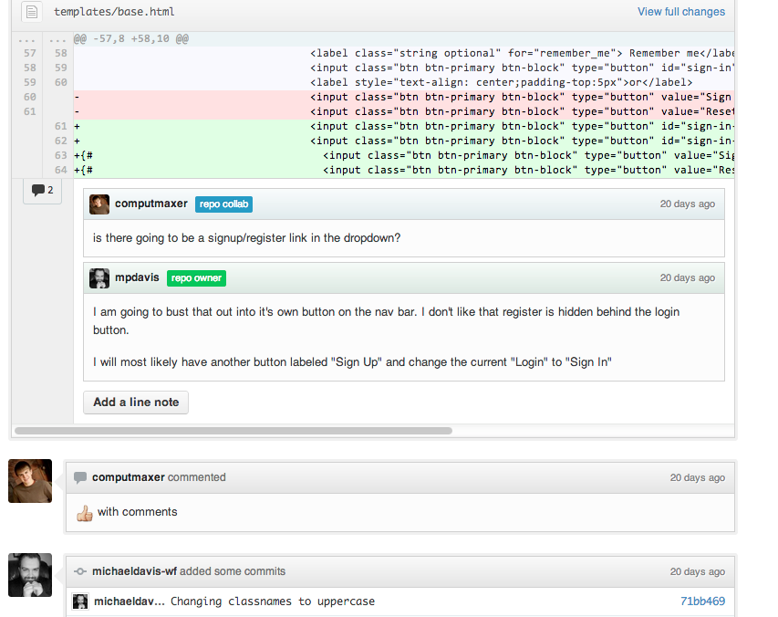
Github

Slide 16
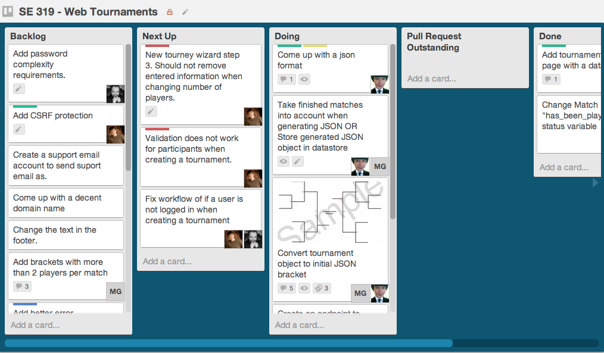
Trello

Slide 17

3
DEVELOPMENT
PROCESS
Notes:
Since we have mentioned the user interface, let’s take a look at our application.
Move to the next slide after 3 seconds

Slide 18
Responsibilities of Members
User authentication and management
Michael Davis
Tournament Logic / Model Scheme
Taehyun Park, Mark Gollnick
Tournament Web Interface
Robert Sheehy, Maxwell Peterson

Slide 19
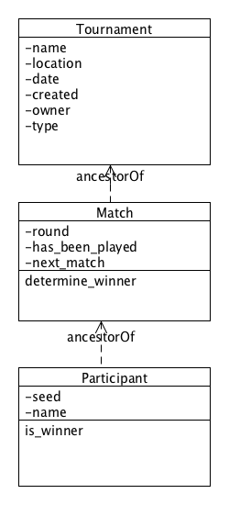
Old UML Diagram

Slide 20
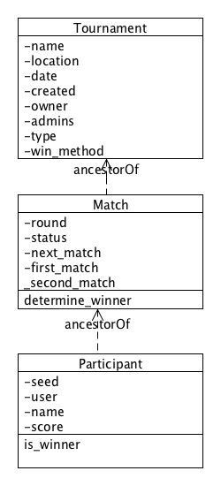
New UML Diagram

Slide 21
Timeline
OCT
Basic user creation and authentication
OAuth authentication (Google, Facebook)
Database design finalized
Basic tournaments running
Web interfaces mocked up and working
Advanced tournaments running
REST API
Notes:
Current
Basic user creation and authentication
Mid-October
Database design finalized
Basic tournaments running
Web interfaces mocked up and working
End of October
Advanced tournaments running
Sharing tournaments with friends (Facebook/Twitter)

Slide 22
NOV
Polished user interfaces
Sharing tournaments with friends (Facebook)
Beta testing and fixes
Betting odds calculator
DEC
1.0 Release
Continued support
Feature requests
Notes:
Mid-November
Polished user interfaces
Beta testing and fixes
Betting odds calculator
End of November
1.0 Release
Future
Continued support
Feature requests

Slide 23
Challenges
Drawing Tournaments on the screen
Cross Browser Support
Tournament Generation Algorithm
Single Elimination
Double Elimination

Slide 24










APPLICATION
4
5 MINS
DEMO
Notes:
Move to the next slide after 4 seconds

Slide 25
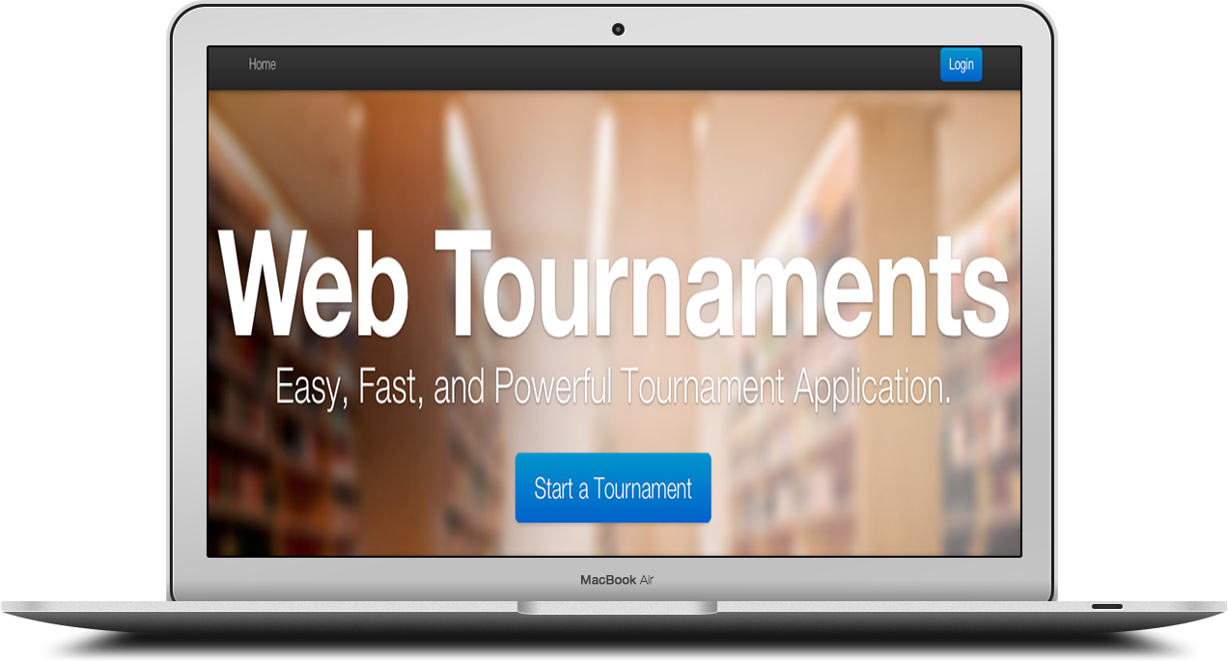
Demonstration

Slide 26
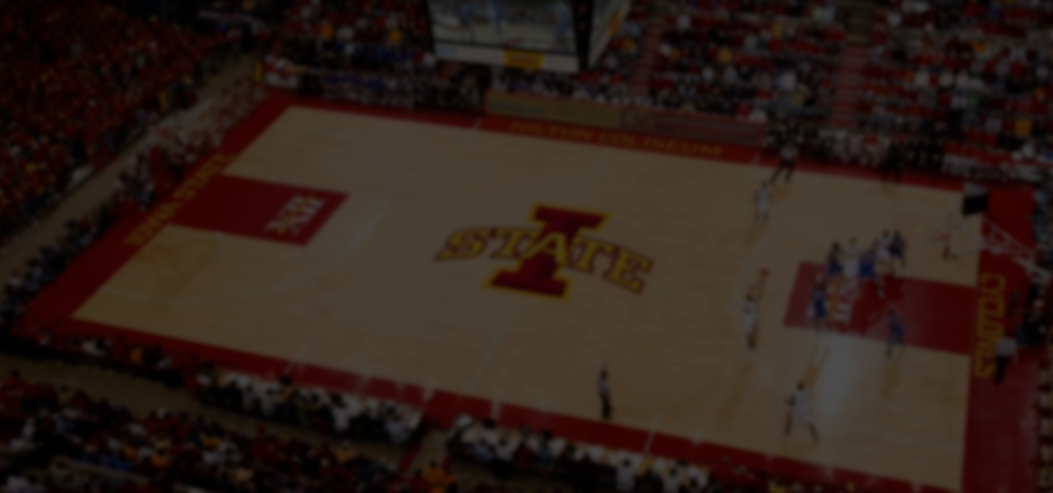
QUESTIONS?

Slide 27
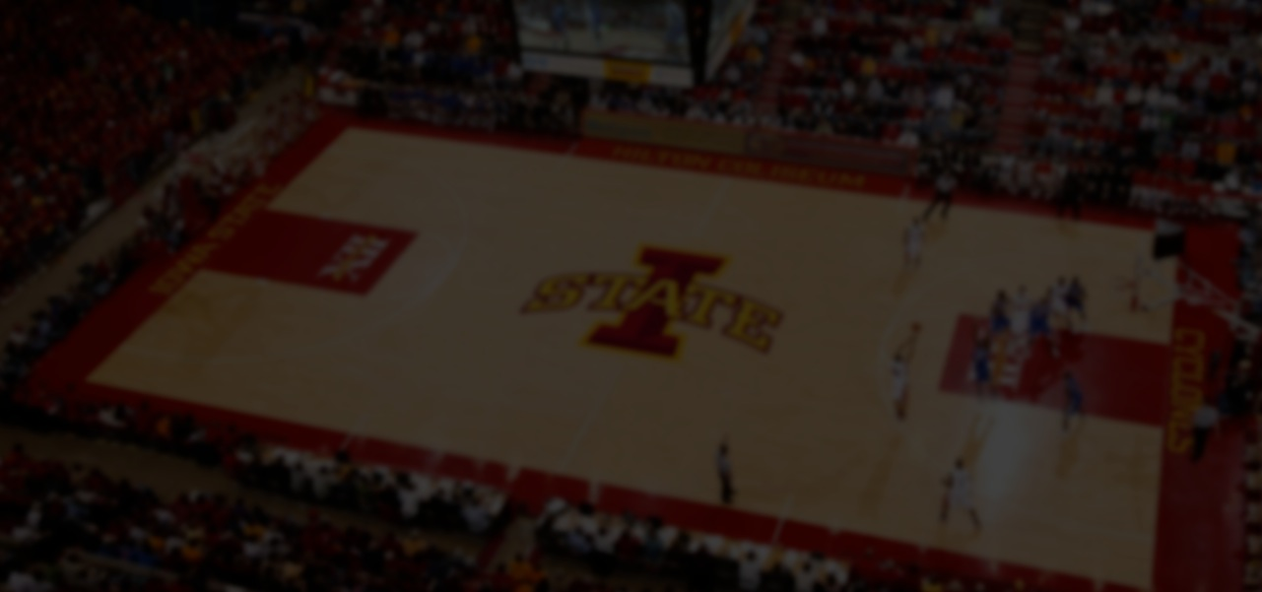
THANK YOU

